Slide 1

Part B Convolutional Neural Network (Cifar10)
NAME: AW SHAO YANG
STUDENT ID: P2012126
CLASS: DAAA/FT/2B/03

Slide 2
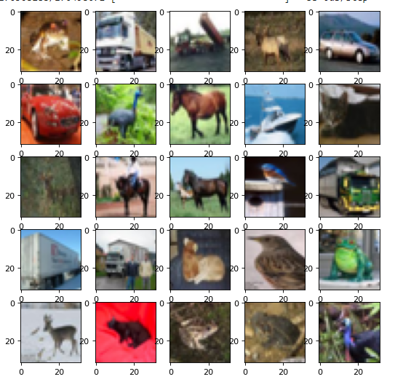
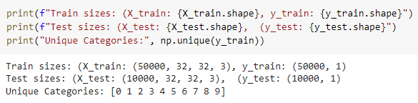
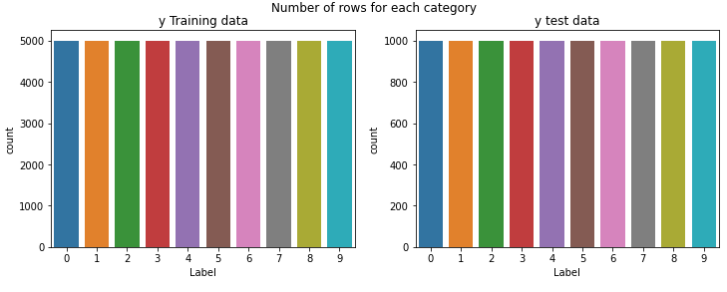
Through external research about the dataset we are handling, I have found that the classes of the images in this dataset are as follows
airplane
automobile
bird
cat
deer
dog
frog
horse
ship
truck
Data Exploration
Through the images we see that:
Our images are colored (RGB)
There appears to be more than 2 categories
We have 50000 images to train while our test set has 10000 images
The images are of pixel size 32 x 32 (Resolution is not very good)
When building the model, we will need to take these factors into account
Since the final model has 10 categories, we set the final output layer to have only 10 nodes, 1 node per category
Images will have an input of 32 x 32 x 3 channel in the input layer for CNN since the images are RGB colored
We see that the distribution of labels are equal around all categories, with each label having 5000 training entries and 1000 testing entries
This equal distribution ensures that that our prediction classes are not biased due to imbalance classes

Slide 3
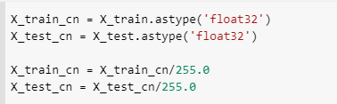
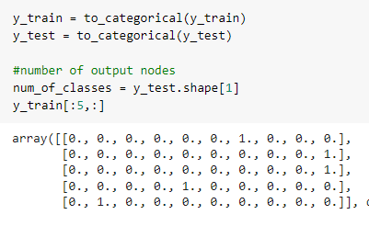
Data Preparation
As for this dataset, I started with a CNN unlike part A which I created a Basic Neural Network. This is because from part A, we already saw the prediction benefits of introducing Convolution and Max Pooling to a model as compared to just a simple ANN
We do not need to reshape the data since the data was already in an appropriate 50000 x 32 x 32 x 3 channel for us to use to train the model.
However we still need to conduct Normalization by dividing it with its max pixel value
From data exploration, we see that the output variable is an integer from 0 to 9.
However, since this is a multiclass classification problem, it is good practice to use a one hot encoding of the class values, transforming the vector of class integers into a binary matrix

Slide 4
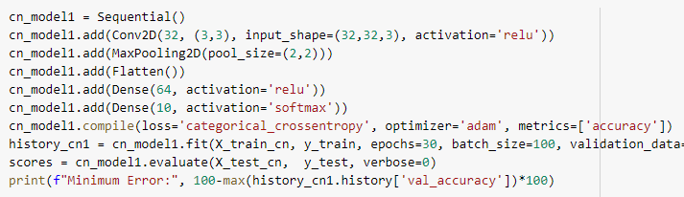
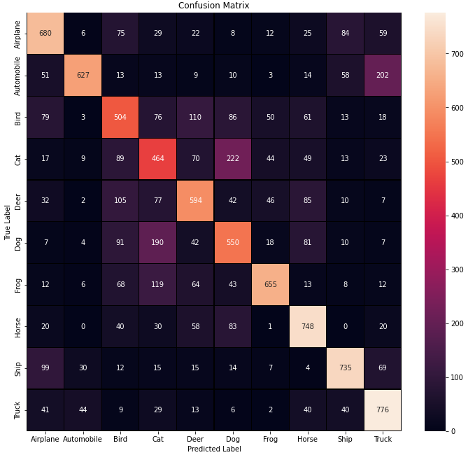
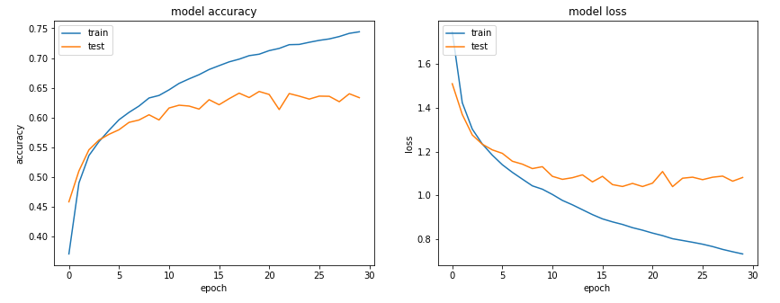
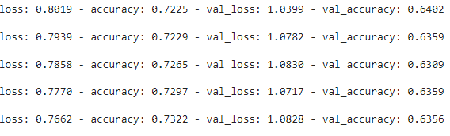
Neural Network Architecture (Baseline)
Model Performance
From the results, we see that the baseline model that we have built here has performed quite poorly in its predictions. We were only able to obtain a highest maximum validation accuracy of around 64% ~ 65% while the training accuracy continuously increases overtime causing quite big overfitting and quite early in the model
The first model that I have made for this dataset was a CNN model similar to the baseline model for part A of the project. This is its architecture:
Convolutional Layer (32 filters, kernel size 3x3, ReLu)
Max Pooling layer (Pool size 2,2)
Dense Layer 64 Nodes (Activation function ReLu)
Output Layer 10 Nodes (Activation function SoftMax)
Loss categorical cross entropy, optimizer Adam(0.001)
Batch Size (100), Epochs (30)
Most errored label is the cat class, where it is confused with other mammals (mostly dogs)
Many mammals predicted incorrectly may be due to their appearances
Best animal predicted was Horse
Vehicles classified a lot better
Worst vehicle predicted was automobile while best vehicle predicted was Truck

Slide 5
CNN Hyperparameter Tuning
Here are the things that I tried to improve my CNN model’s accuracy performance and reduce its model overfitting. (All attempts can be found in the ipynb file)
(Successful) were the optimizations conducted that had successful improvements to the model at its predictions or overfitting
(No changes) were the optimizations that worsened the model or did not change the model’s performance
Hyperparameter tuning was done in order of the lists numbers (Left to Right)
Model Architecture Complexity
Conv2D and Max Pooling set Adjustment
2 sets (Successful) (0.7)
3 sets (Successful) (0.72)
4 sets (Successful) (0.75)
Inclusion of Padding (Successful) (0.74)
Conv2D Stacking
2 per stack (Successful) (0.78)
3 per stack (No changes)
Hidden layer adjustment
2 layer (No changes)
3 layer (No changes)
Hidden layer Node adjustment (No changes)
6. Inclusion of Batch Normalization (Successful) (0.81) (less overfitting)
7. Inclusion of Dropout (Successful) (0.86) (less overfitting)
Layer Hyperparameters
9. Dropout Rate Adjustment (Successful) (less overfitting)
10. Learning Rate and Optimizer
11. Activation Function
12. Batch Size
13. Inclusion of Data Augmentation (will be discussed later)

Slide 6
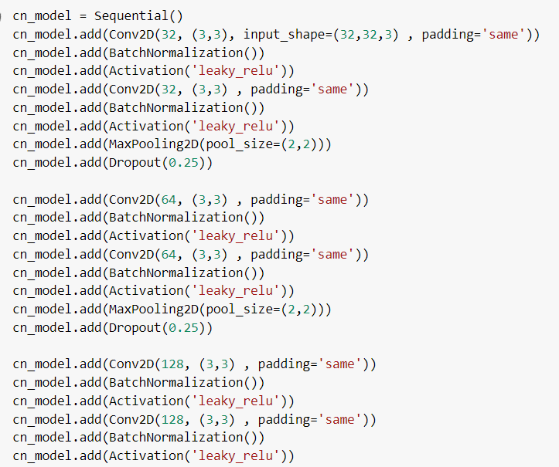
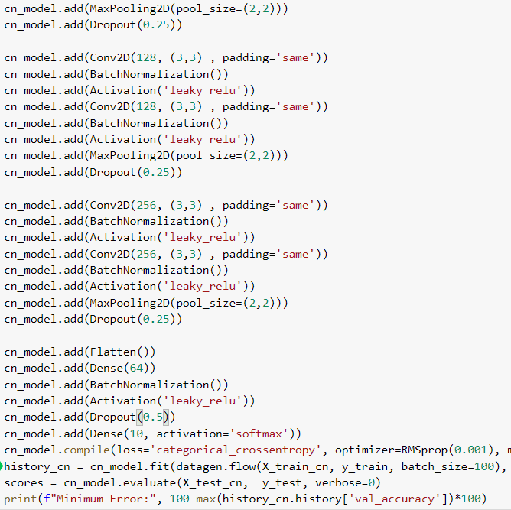
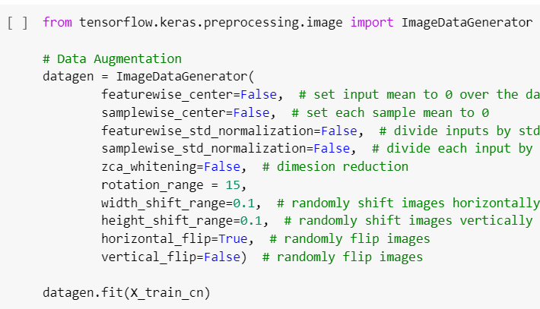
CNN with Data Augmentation
Here is where I applied data augmentation to my model fitting. This was meant to try and increase the model’s validation accuracy as well as reduce the models overfitting even further.
Feature Engineering
These are the image augmentations that I have applied for my data
Rotation
Width and Height Shift
Horizontal Flip
Unlike the model for part A, I did not need to adjust the model’s drop rates. This is due to me only using a drop rate of up to 0.3 on my model as using higher drop rates seemed to decrease my accuracy

Slide 7
CNN with Data Augmentation model results

Slide 8
Final Model Evaluation

Slide 9
Model Performance Comparison

